Slide 1
Enhancing Very Fast Decision Tree with Local Split-Time Predictions
Fresh business general template
Applicable to enterprise introduction, summary report, sales marketing, chart data
M10815021 吳婉菱
M10815017 張代杰
M10815095 彭政嘉
Losing, V., Wersing, H., & Hammer, B. (2018, November). Enhancing Very Fast Decision Trees with Local Split-Time Predictions. In 2018 IEEE International Conference on Data Mining (ICDM) (pp. 287-296). IEEE.
汇报人：优品PPT

Slide 2
01
Introduction
Problems in Mining Data Streams
02
Classification of stream data
outline
Very Fast Decision Tree
Enhancing VFDT with Local Split-Time Prediction : One-sided Minimum
03
Experiment Results
04
Conclusion

Slide 3
01
Introduction
Problems in Mining Data Streams
02
Classification of stream data
outline
Very Fast Decision Tree
Enhancing VFDT with Local Split-Time Prediction : One-sided Minimum
03
Experiment Results
04
Conclusion

Slide 4
Introduction
Data Stream
Characteristic
Volume of data is extremely high
Arrive continuously
Fast changing
Applications of data stream
Phone call records
Network Monitoring
Financial application (stock exchange)
B. Babcock, S. Babu, M. Datar, R. Motwani, and J. Widom. Models and Issues in Data Stream Systems. ACM SIGMOD/PODS 2002 Conference.
Notes:
串流資料特徵：
資料快速持續到達，潛在大小也許是無窮無盡的
資料來源眾多，格式複雜
應用:
金融機構即時追蹤股市的變動、計算風險值，以及根據股價波動來自動重新平衡投資組合。

Slide 5
Introduction
Problems in Mining Data Streams
Traditional data mining techniques usually require
Entire dataset to be present
Random access to the data
Challenges of stream mining
Impractical to store the whole data
Rapid and continuous loading of individual data items
Notes:
挑戰:
資料量大，但不是十分關注儲存

Slide 6
Introduction
Challenge
Classic
Decision tree learner assume all training data can be stored in memory simultaneously.
Goal
Design a decision tree learner that
read each example at most once
use a small constaint time to process it

Slide 7
01
Introduction
Problems in Mining Data Streams
02
Classification of stream data
outline
Very Fast Decision Tree
Enhancing VFDT with Local Split-Time Prediction : One-sided Minimum
03
Experiment Results
04
Conclusion

Slide 8
Classification of stream data
Very Fast Decision Tree
- Main Idea
Designed for extremely large dataset
Find the best attribute at a given node by considering only a small subset of training examples that pass through the node
How many examples are sufficient?
P. Domingos and G. Hulten, “Mining high-speed data streams,” in Proc. of the Sixth SIGKDD International Conference on Knowledge Discovery and Data Mining, 2000.

Slide 9
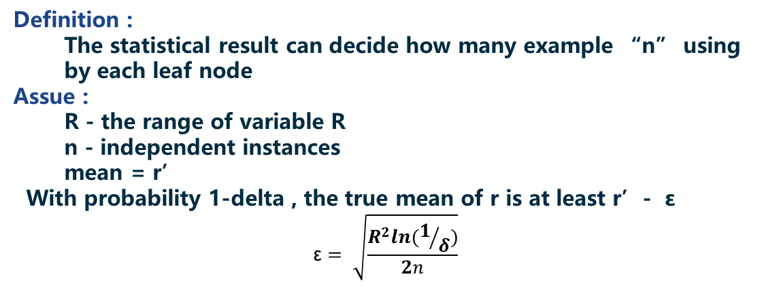

Classification of stream data
Very Fast Decision Tree
- How many examples are enough?
Hoeffding Bounding
n is bigger, ε gets smaller

Slide 10
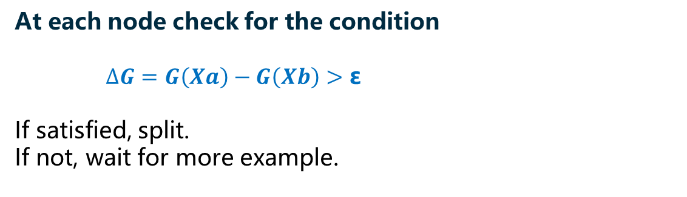
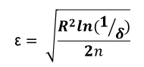
Classification of stream data
Very Fast Decision Tree
Calculate the information gain and pick up the best two attributes
Data Stream
Split Criterion
∆G > ε
Hoeffding Bounding

Slide 11
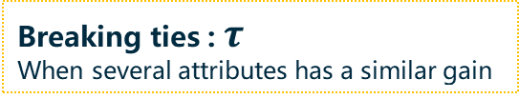
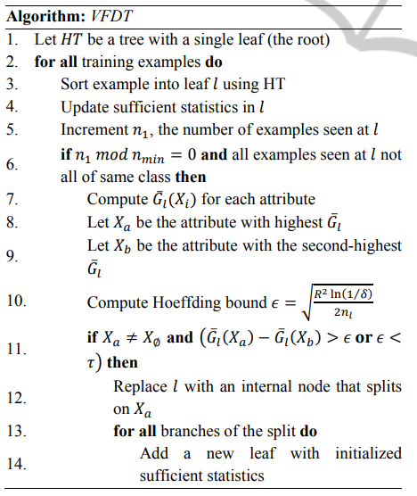
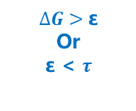

Classification of stream data
VFDT Algorithm
root
Add sample to leaf node
#Samples
mod $n_{min}$
Calculate Information gain
Non-split
Split

Slide 12
01
Introduction
Problems in Mining Data Streams
02
Classification of stream data
outline
Very Fast Decision Tree
Enhancing VFDT with Local Split-Time Prediction : One-sided Minimum
03
Experiment Results
04
Conclusion

Slide 13
Classification of stream data
Enhancing VFDT with local split-time prediction : One-sided Minimum
VFDT
OSM
Use local statistics to predict the split time
→ avoid unnecessary split-attempt
Losing, V., Wersing, H., & Hammer, B. (2018, November). Enhancing Very Fast Decision Trees with Local Split-Time Predictions. In 2018 IEEE International Conference on Data Mining (ICDM) (pp. 287-296). IEEE.

Slide 14
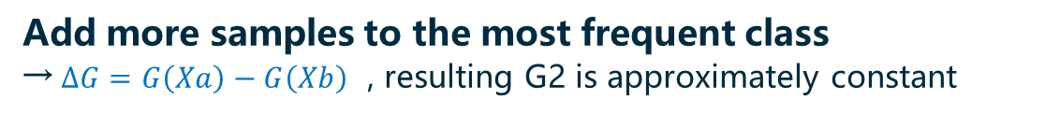
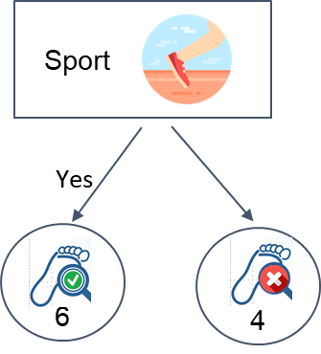
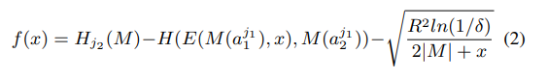
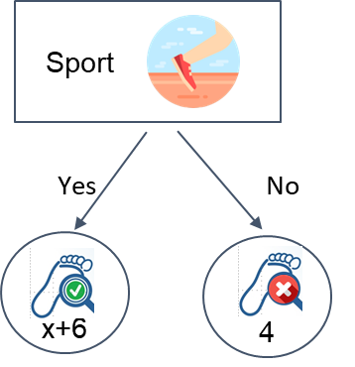
Classification of stream data
Enhancing VFDT with local split-time prediction : One-sided Minimum
- Use Local Statistics to predict the split time
Split time predict function – Brent’s method
G2
Add x samples
G1 (X)
ε
X : the number of example should be added

Slide 15
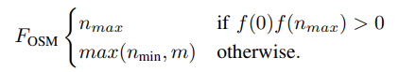
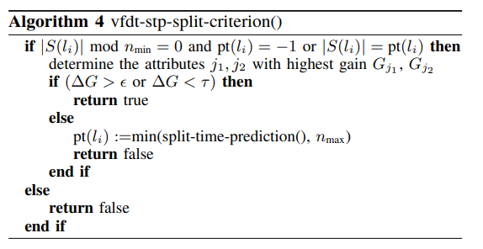
Classification of stream data
Enhancing VFDT with local split-time prediction : One-sided Minimum
- Use Local Statistics to predict the split time
Split time predict function
Split criterion

Slide 16
01
Introduction
Problems in Mining Data Streams
02
Classification of stream data
outline
Very Fast Decision Tree
Enhancing VFDT with Local Split-Time Prediction : One-sided Minimum
03
Experiment Results
04
Conclusion

Slide 17
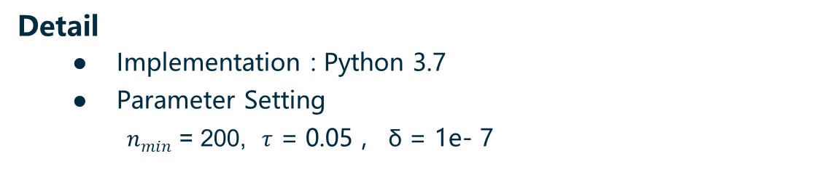
Experiment Result
Overview
Characteristics of dataset
Dataset | #Samples | #Feat. | #Class | Type
Cover Type | 581k | 54 | 7 | Real-world
Poker | 829k | 10 | 10 | Real-world
Detail
● Implementation : Python 3.7
● Parameter Setting
$n_{min}$ = 200, $τ$ = 0.05 , δ = 1e- 7
Notes:
Forest Cover Type
→包含從美國森林服務（USFS）區域2資源信息系統（RIS）數據獲得的30 x 30米單元的森林覆蓋類型。
撲克手數據集的每個記錄都是一筆instance，該手由從52張標準牌組中抽出的五張撲克牌組成。
→每張紙牌使用兩個屬性（花色suit和rank）進行描述，總共具有10個預測屬性。 有一個類別屬性描述“撲克手”像是one pair,full house等等。

Slide 18
Experiment Result
Split-Delay v.s Split-Attempt
 | n_min = 50 |  | n_min = 200
Dataset | # attempt |  | # attempt
 | VFDT | OSM | VFDT | OSM
Cover Type | 10,995 | 497 | 2,741 | 487
Poker | 16,490 | 363 | 4,098 | 399

Slide 19
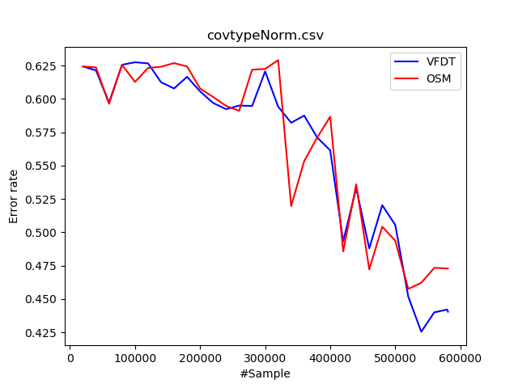
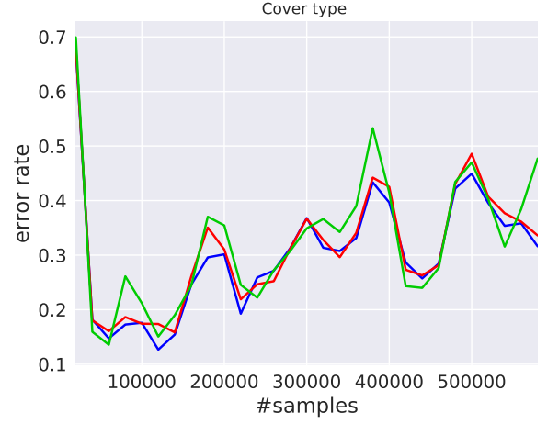
Experiment Result
Error Rates – Forest Cover Type
Our work
Paper

Slide 20
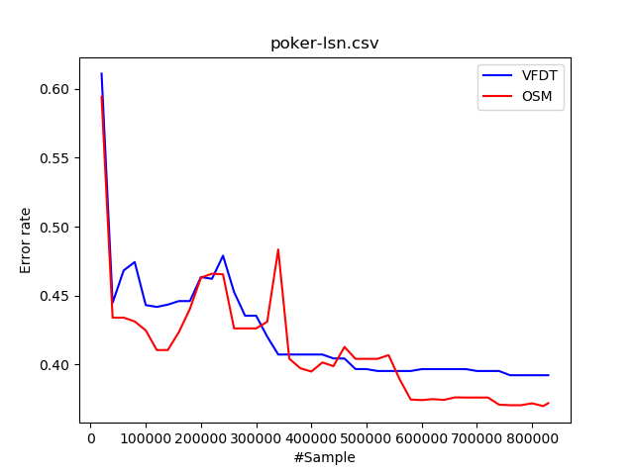
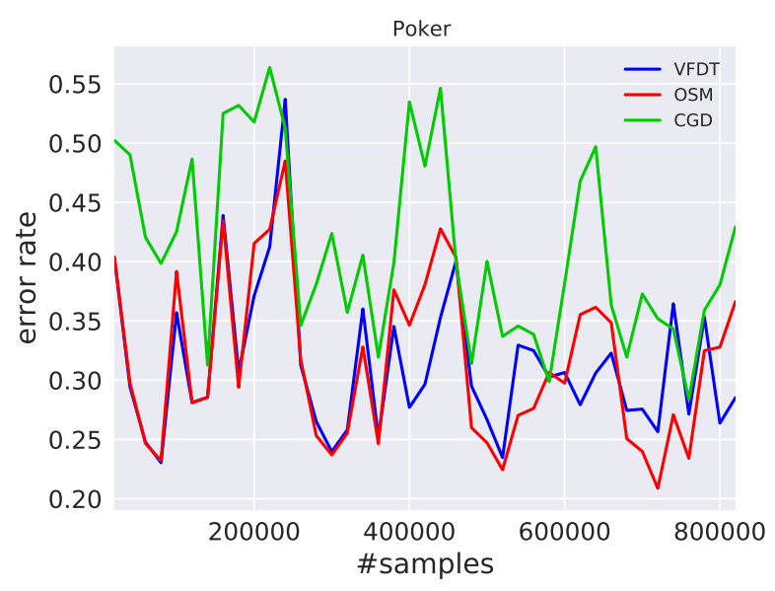
Experiment Result
Error Rates - Poker
Our work
Paper

Slide 21
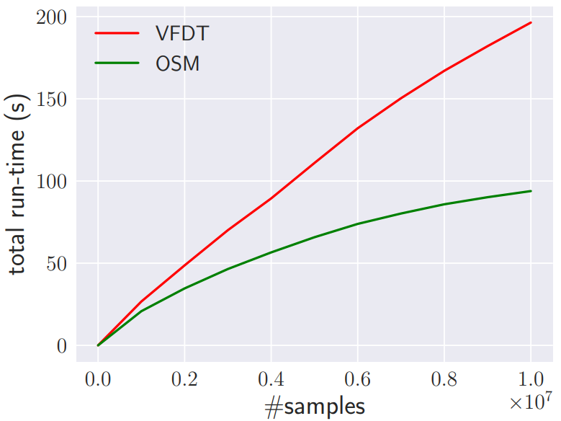
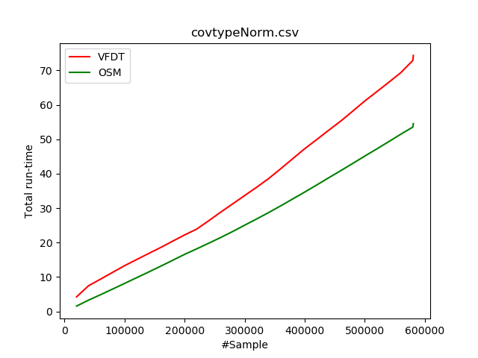
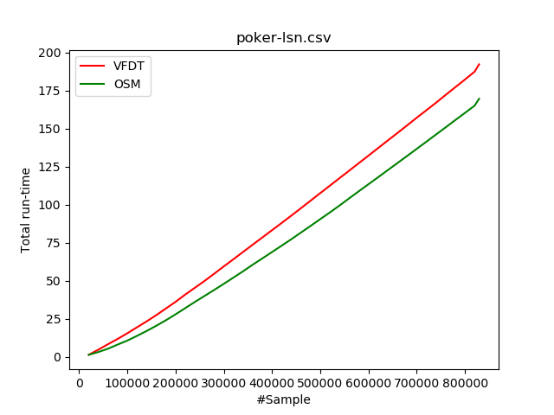
Experiment Result
Computation Time
Paper
Forest Cover Type
Poker

Slide 22
01
Introduction
Problems in Mining Data Streams
02
Classification of stream data
outline
Very Fast Decision Tree
Enhancing VFDT with Local Split-Time Prediction : One-sided Minimum
03
Experiment Results
04
Conclusion

Slide 23
Conclusion
The author improved the efficiency of the VFDT by replacing its periodic split-attempt scheme.
→ use the local statistics within a leaf to accurately predict its split-time.
The author empirically showed a distinct speed-up of our approach in comparison to the default VFDT

Slide 24
Demo

Slide 25
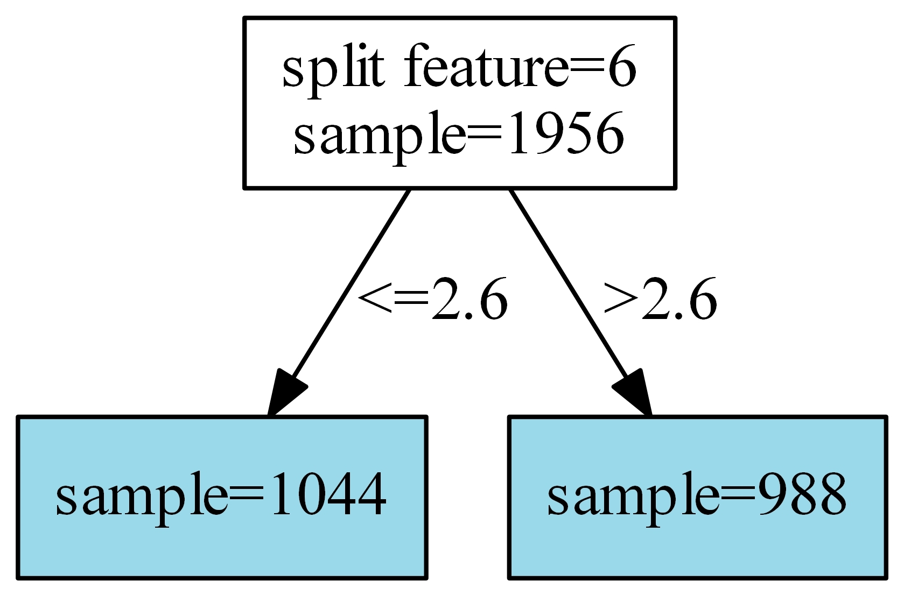
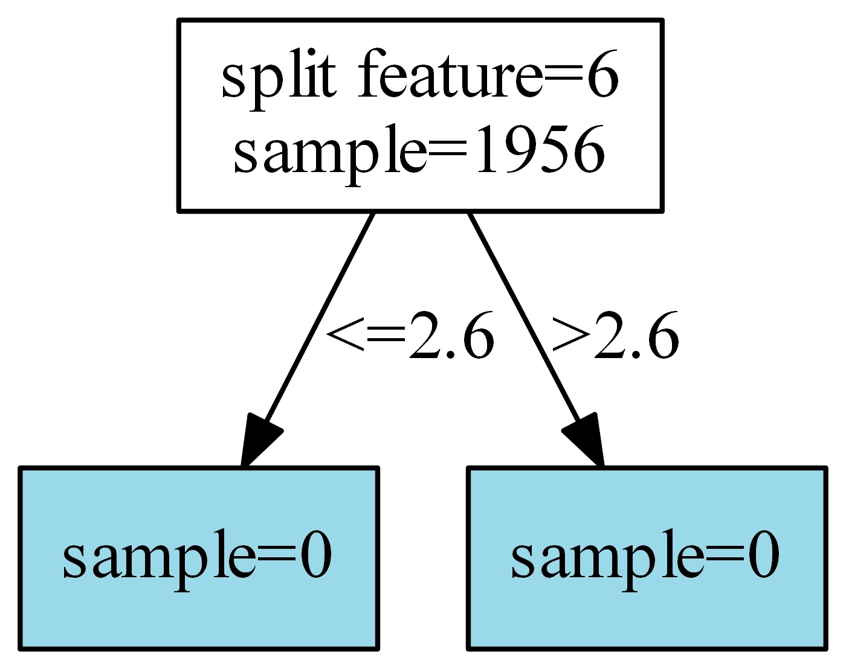
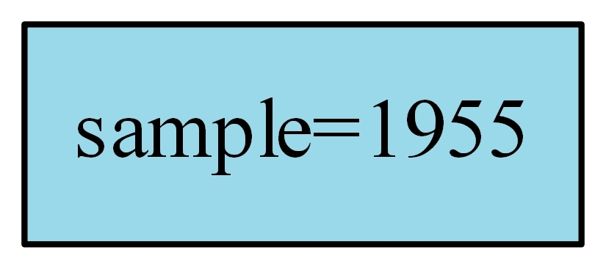
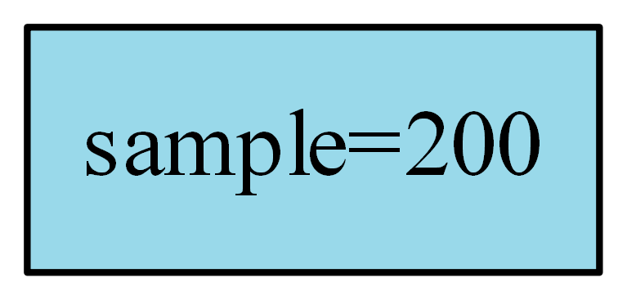
Demo
Visualize Tree

Slide 26
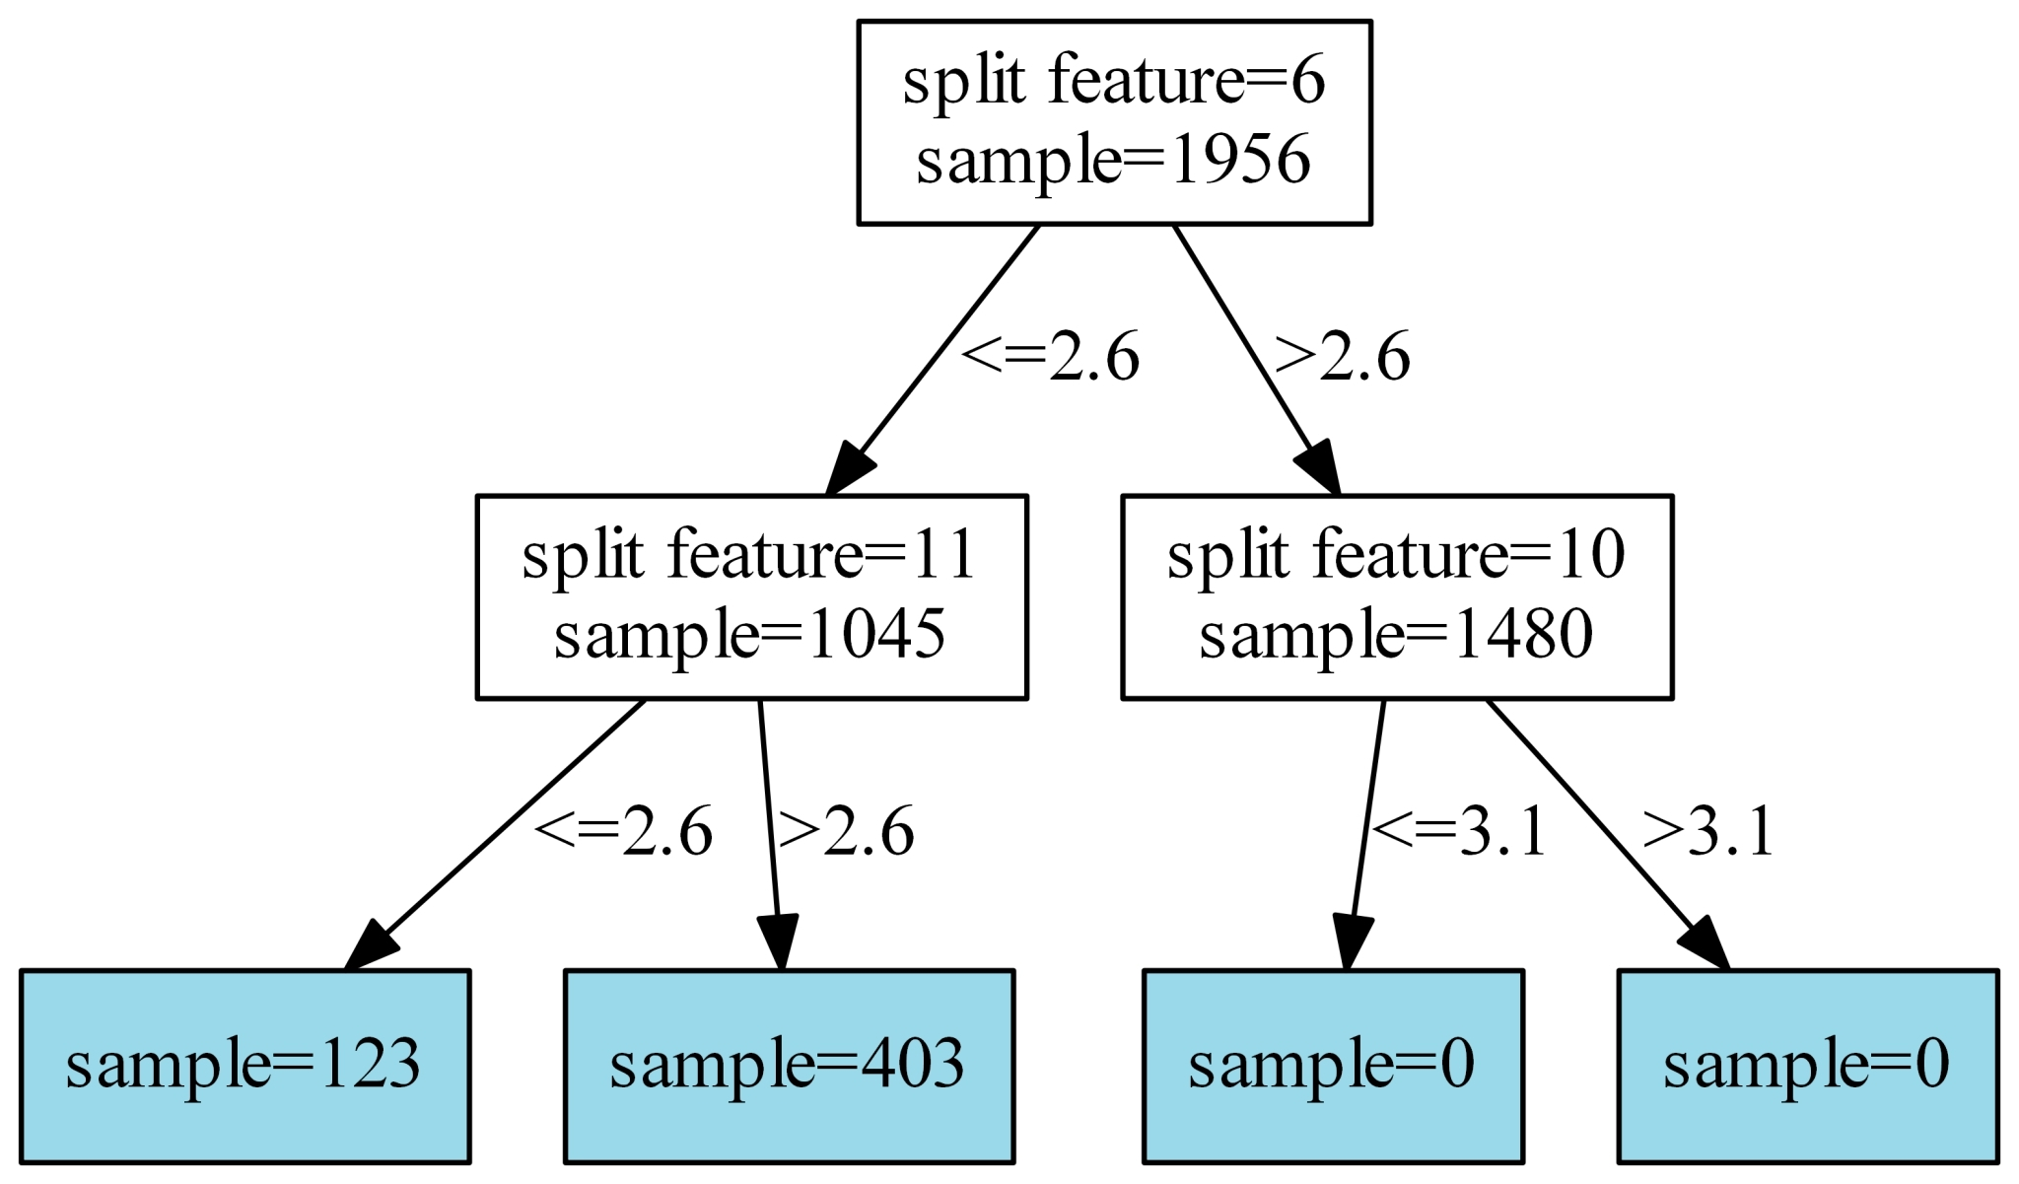
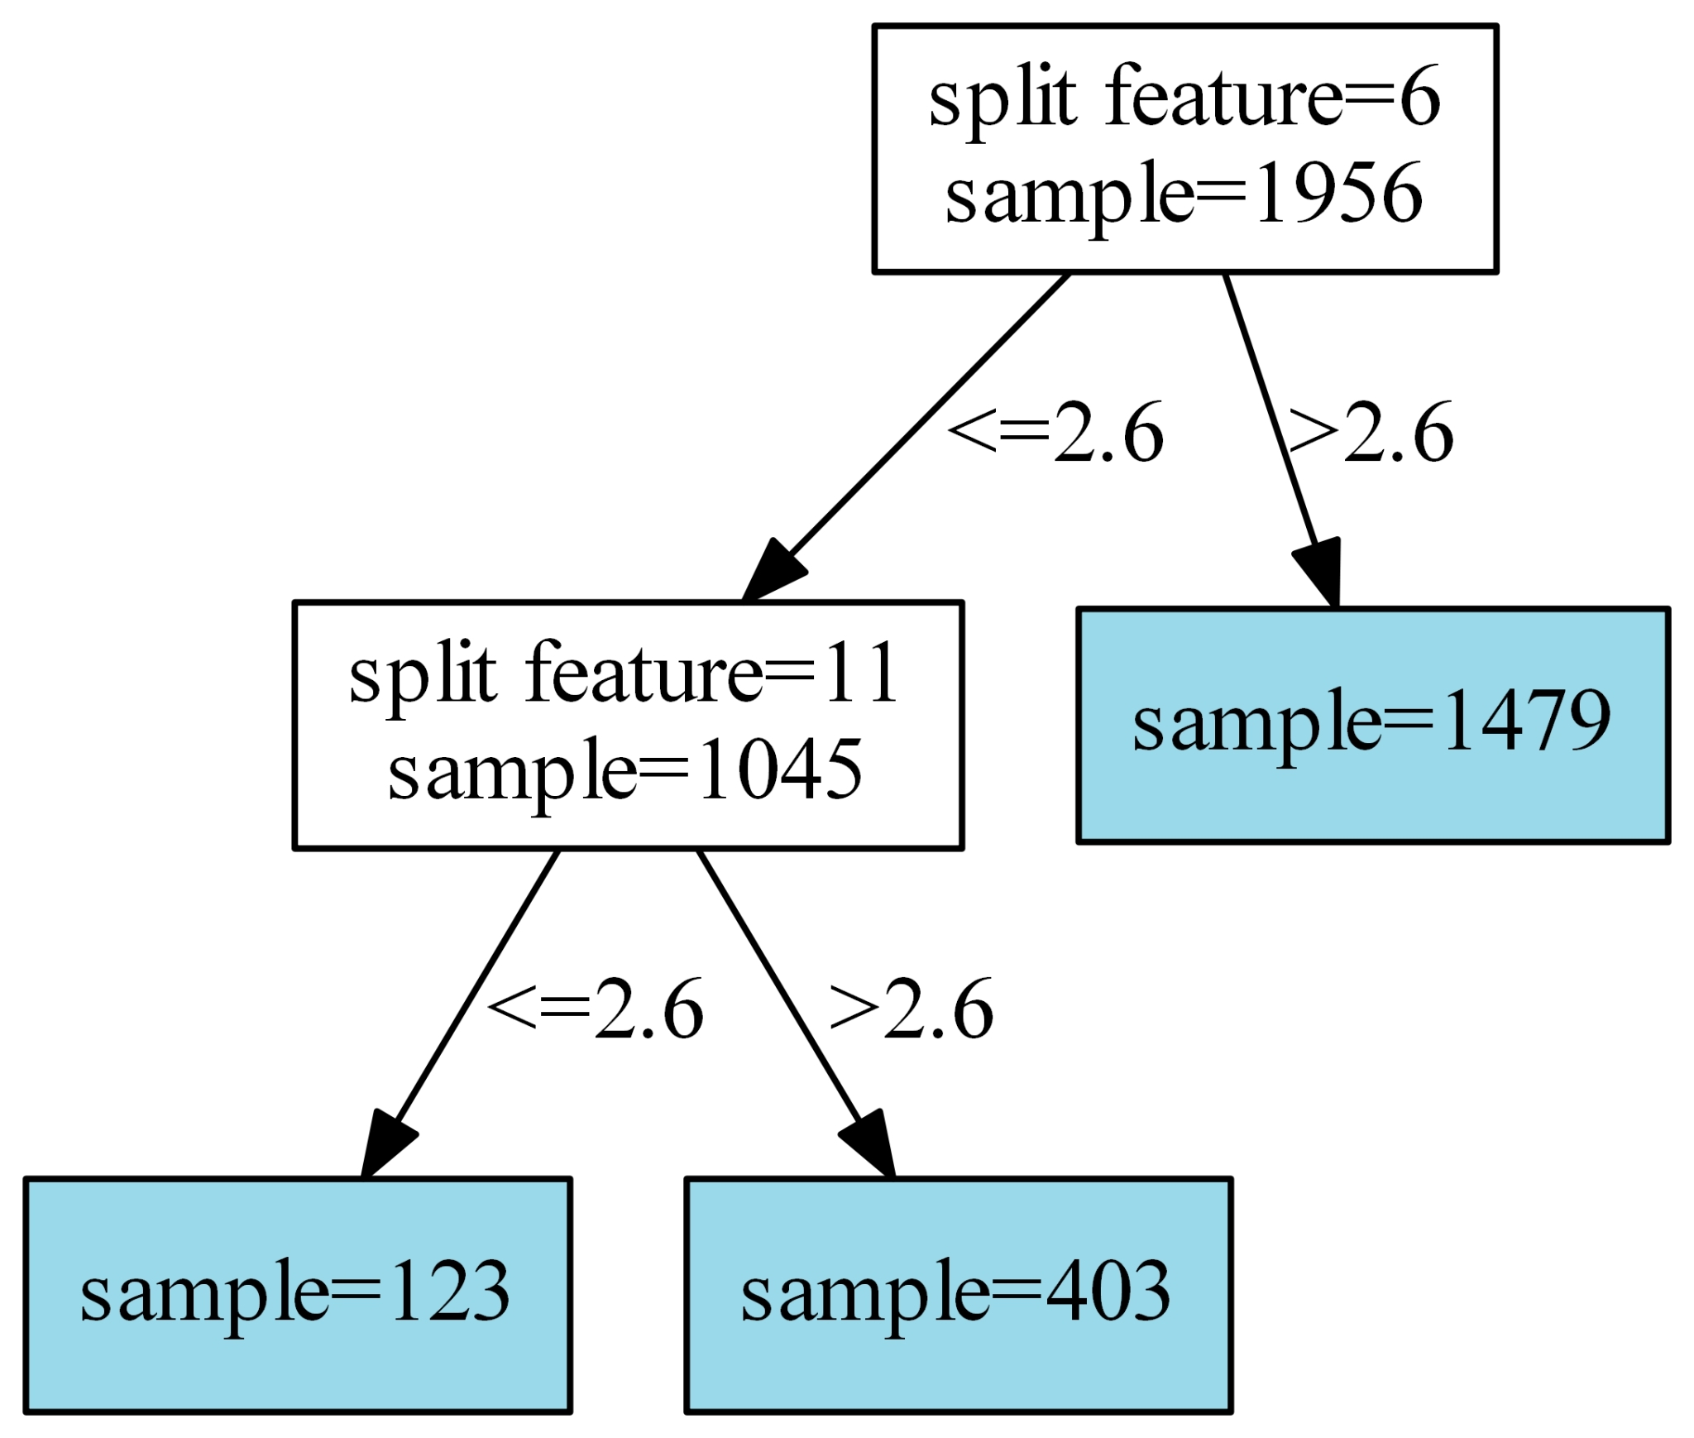
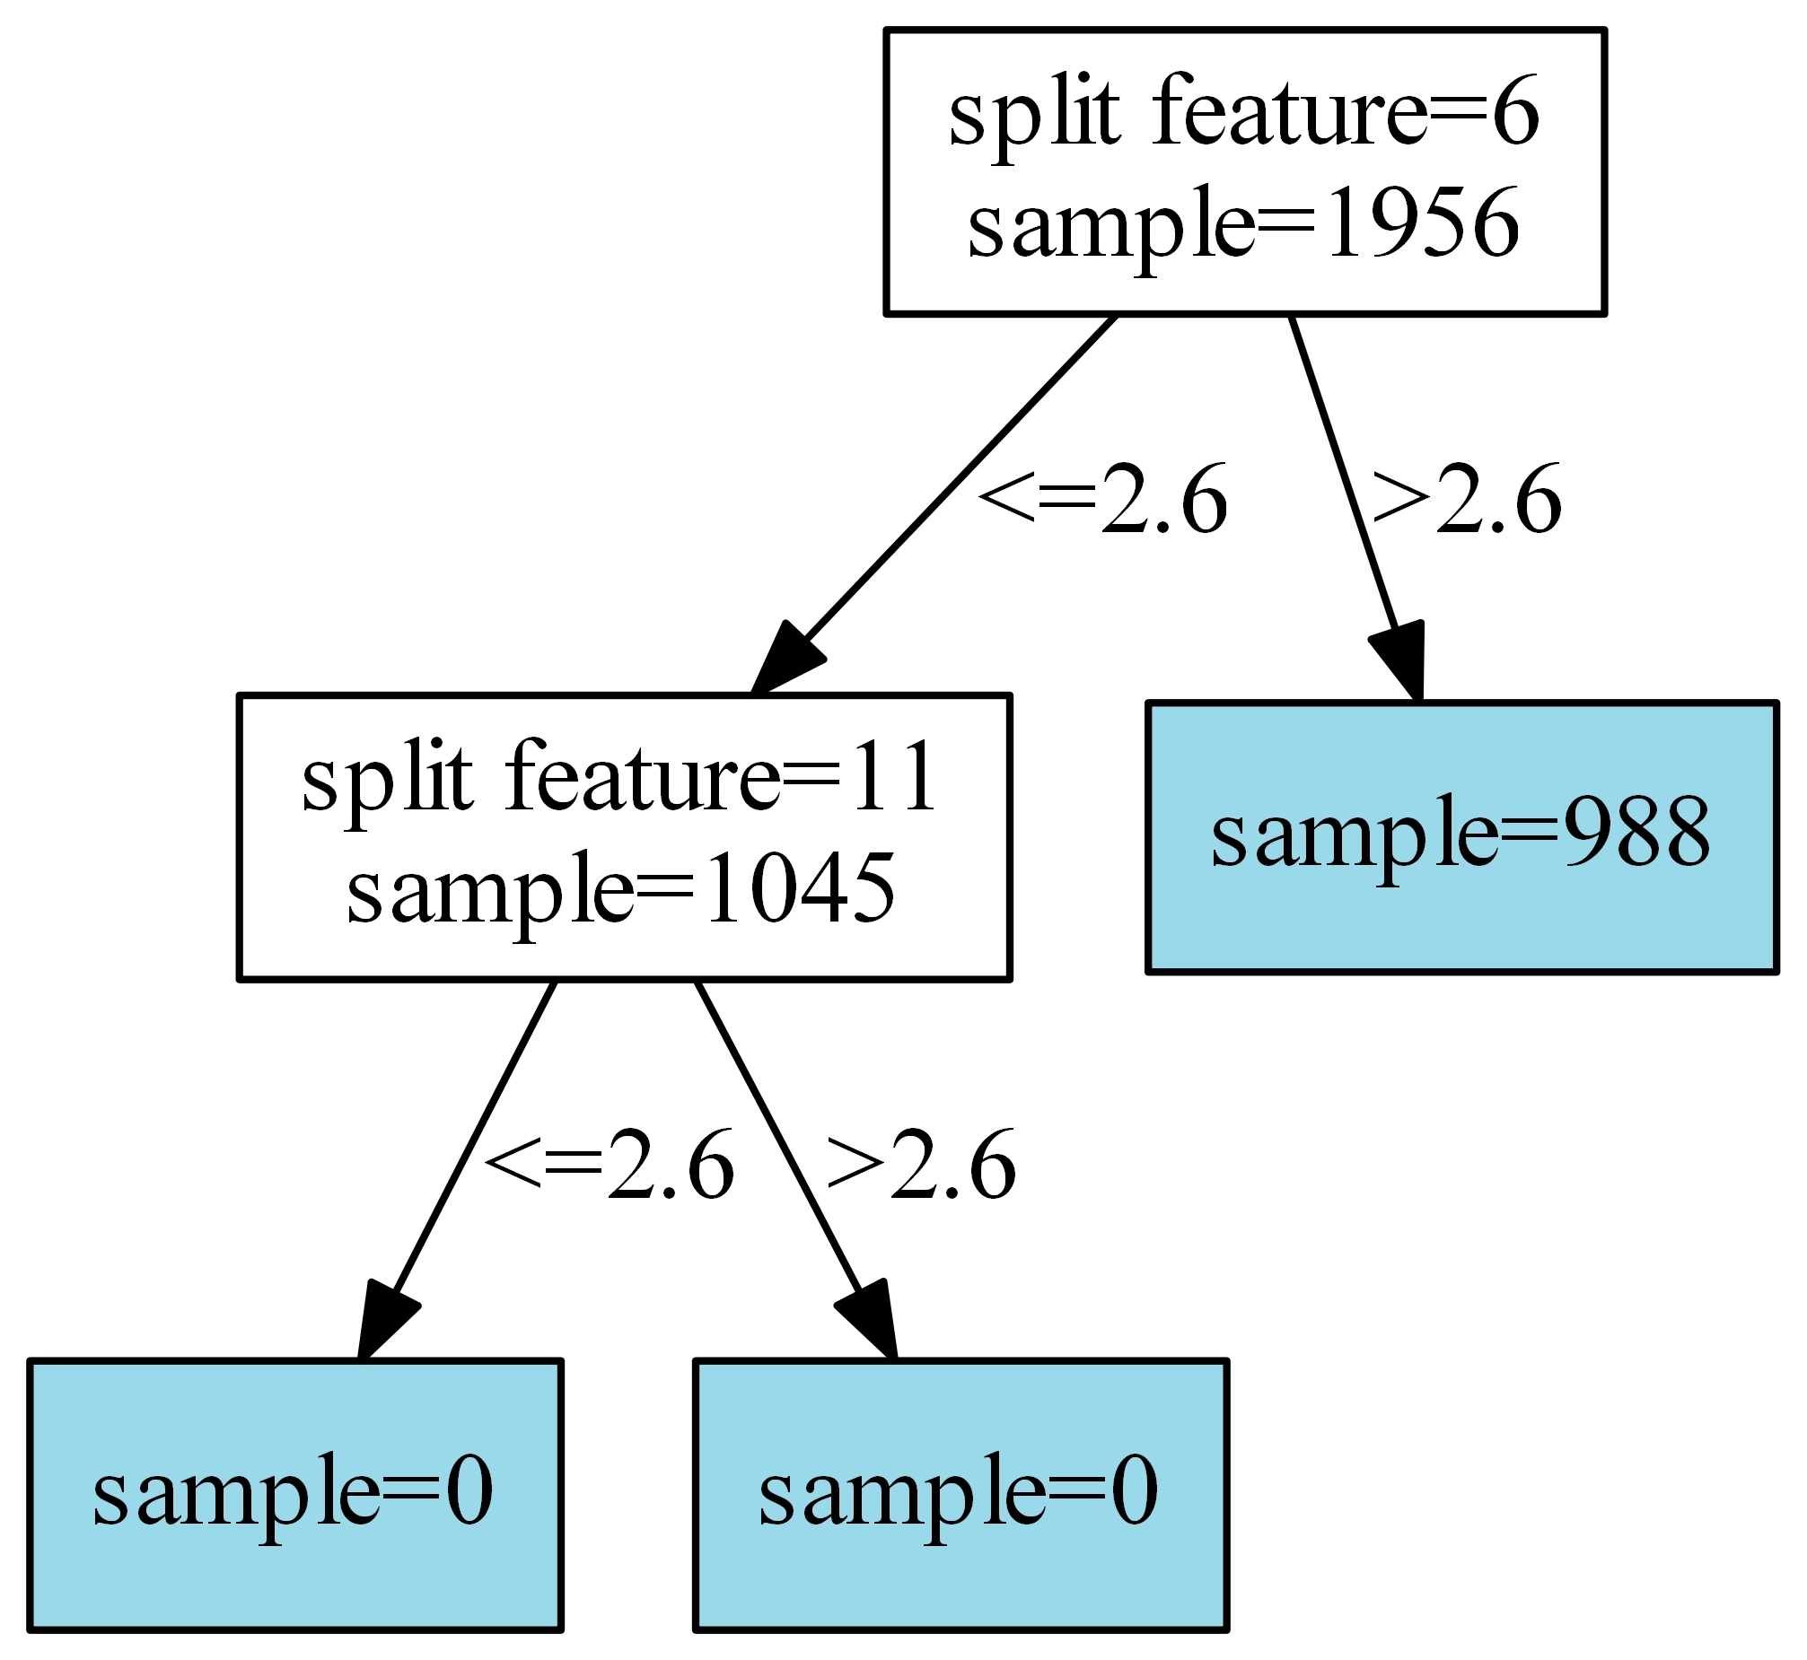
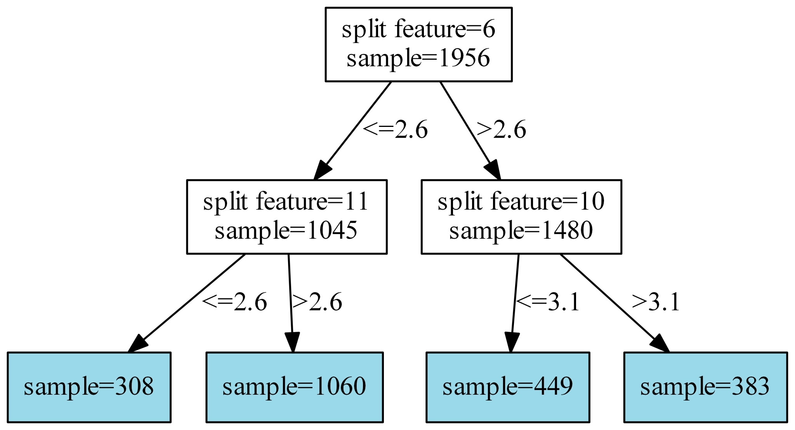
Demo
Visualize Tree

Slide 27
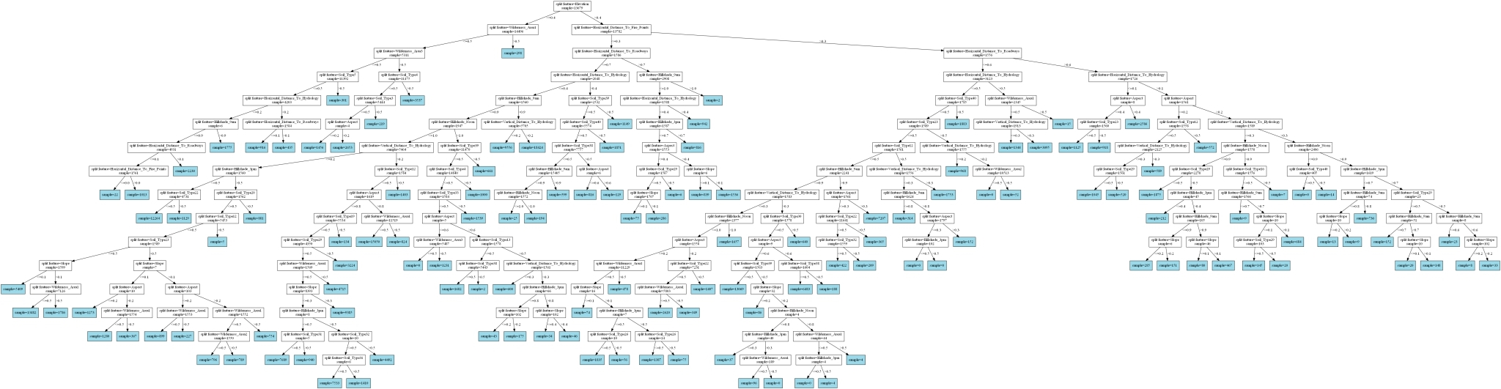
Demo
Visualize Tree – OSM Forest Cover Type

Slide 28

Q&A

Slide 29



Data Stream
Split Criterion
Sport
Yes
No
∆G > ε
x+6
4
Hoeffding Bounding

